Slide 1
Introduction to Recursion
Life Choices Coding Academy 2020

Slide 2
Learning outcome:
By the end of this section, student should be able to:
Demonstrate basic understanding of recursion.
Notes:
https://www.quora.com/What-is-the-fastest-sorting-algorithm?share=1

Slide 3
So what is recursion:
Method of solving a problem where the solution depends on solutions to smaller instances of the same problem.
Such problems can generally be solved using loops.
Most programming languages support recursion by allowing a function to call itself.
A recursive function consists of two parts: the recursive call and the base case.
Notes:
Recursion is a method of solving problems that involves breaking a problem down into smaller subproblems until yo get to a small enough problem that it can be solved trivially. Usually recursion involves a function calling itself.

Slide 4
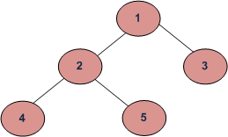
When to use recursion over iteration:
In programming some problems are more easily solved using recursive functions.
For example:
- Traversing through a directory or file system.
- Traversing tree
- Traversing a graph
- The problem is naturally recursive (e.g Fibonacci)
Notes:
One good example of this would be searching through a file system. You could start at the root folder, and then you could search through all the files and folders within that one.
After that, you would enter each folder and search through each folder inside of that.
Recursion works well for this type of structure because you can search multiple branching paths withoutt having to include many different checks and condition for every possibility.

Slide 5
Structure of Recursive Functions
A recursive implementation always has two parts:
Base case, which is the simplest, smallest instance of the problem.
Recursive step, which decomposes a large instance of the problem into one or more simpler or smaller instances that can be solved recursively.
Notes:
Base cases often correspond to emptiness.

Slide 6
Factorials(Example)
Computing factorials are a classic problem for examining recursion
A factorial is defined as follows:
N! = n x ( n - 1 ) x ( n - 2 )... x 1;
For example:
1! = (Base Case)
2! = 2 x 1 = 2
3! = 3 x 2 x 1 = 6
4! = 4 x 3 x 2 x 1
Notes:
It tells us that when we are presented with a long list of possibilities, and we're trying to count up how many total outcomes might happen, we can simply multiply by how many possibilities there are at each step of the way. It won't always be the case that the numbers we're multiplying by are decreasing by 1 each step, but it does end up happening a lot. It happens so often, in fact, that mathematicians decided to give the operation its own name, factorial.
What is the practical application of factorials?
In mathematics - Taylor’s theorem, binomial theorem
In statistics - Probability theory.

Slide 7
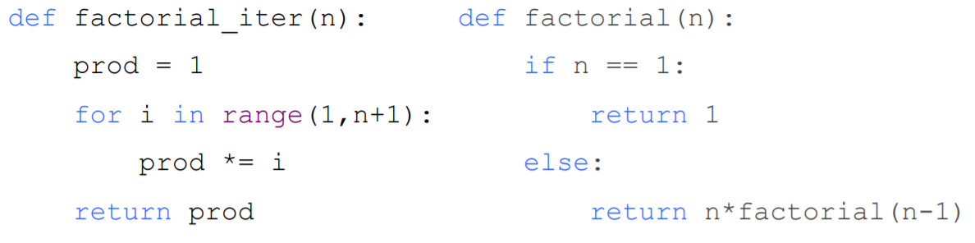
Iteration vs Recursion
Recursion may be simpler, more intuitive
Recursion may be efficient from programmer
Recursion may not be efficient from computer (stack)
Notes:
Recursion involves creating and destroying stack frames, which has high costs.

Slide 8
Recursively Defined Functions
A recursively defined function is a function whose definition refers back to itself. A classic example of such a function is the factorial,
N! = 1 x 2 x 3 .. .. . ….x n

Slide 9
Thanks

